Slide 1




Database Continuous Delivery & Your Salvation!
John Morehouse
Consultant
Denny Cherry & Associates Consulting
john@dcac.co
http://linkedin.com/in/sqlrus
@SqlRUs
http://www.sqlrus.com

Slide 2
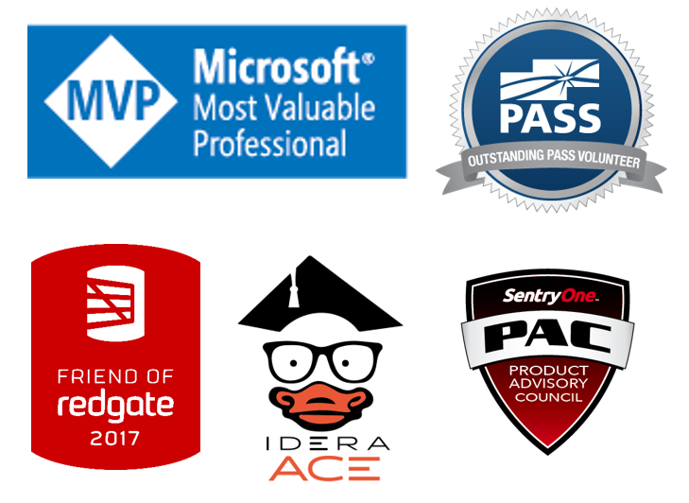
Who Am I?
Leader of the Louisville SQL Server/Power BI User Group
Organizer/Speaker of SQL Saturday’s & other conferences
Heavily involved with SQL PASS
Microsoft Data Platform MVP
Friend of Redgate 2015 - 2018
Idera ACE 2016
SentryOne Product Advisory Council

Slide 3
Where Am I?
The vetted and certified experts at Denny Cherry and Associates Consulting assist companies with attaining IT goals such as HA, scalability, SQL Server virtualization, migration, and acceleration reliably while finding ways to save on costs. With clients ranging from Fortune 50 corporations to small businesses, their commitment to each is the same: to provide a deft, high-speed IT environment that leverages every aspect of their platform: from architecture, infrastructure, to network.
Visit DCAC at http://www.dcac.co

Slide 4

Agenda
What Is It?
How Does It Work?
Why Do I Care?
Security
Standardization & Consistency
Collaboration
Deployments
Demo

Slide 5
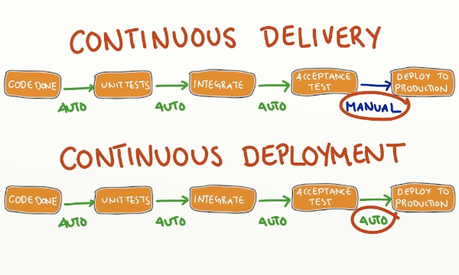
What Is It?
Continuous Delivery
Continuous Deployment
Continuous Deployment = Bad Things
Source: http://blog.crisp.se/2013/02/05/yassalsundman/continuous-delivery-vs-continuous-deployment
Notes:
Continuous Delivery is usually delivery of application/database changes automatically up to the environment just before production. We can go to Production if it was decided, but human intervention is still required. Database continuous delivery is always complicated by the data. We use tools to generate automatic deployment elements (artifacts) to be deployed to various environments.
Continuous deployment is all the way into production once the change is checked into source control and all testing is passed. This requires rock solid testing methodologies on all fronts. Very difficult to accomplish.
Shared development model means that every developer will develop on the same database instance and/or database.

Slide 6

Database Continous Delivery…
Development Model
Dedicated
Shared
Source Control
Redgate Source Control
Visual Studio SSDT
Continuous Integration (CI)
Team City
Jenkins
Artifact
Release Manager
Octopus Deploy
MS Release Manager

Slide 7
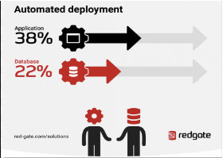
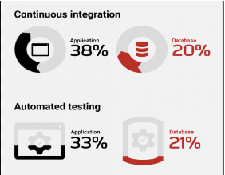
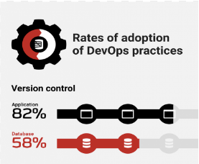
Adoption Rate
1000 SQL Server database professionals
Range of industries and company sizes
Had or planning to adopt DevOps practices in their organization

Slide 8
How It Works
Notes:
Developer develops new database code. The database is under some form of source control, Team Foundation Server of Subversion.
Some method is used to control the database within source control. Red Gate Source Control or Visual Studio SSDT

Slide 9
How It Works
Source Control System
Notes:
Developer develops new database code; checks in the changes into source control.

Slide 10
How It Works
Source Control System
Build Server
Notes:
The Build Server (via continuous integration) recognizes the check in, and begins to build the changes into an artifact. The build process is essentially merging and testing development changes. Usually done on a dedicated server with continuous integration software such as Jenkins or TeamCity.
The artifact is the resulting object, which is a deployable object (think deployment scripts)

Slide 11
How It Works
Source Control System
Build Server
Build & Test
Notes:
If the artifact is successfully built, it moves to the Release Manager. If fails, notify the Developer.
Release manager then determines which environment the artifact needs to be deployed to.

Slide 12
How It Works
Source Control System
Build Server
Passed Tests?
Build & Test
Notes:
The architect is the result, which is a deployable object (think deployment scripts)
If the artifact is successfully built, it moves to the Release Manager. If fails, notify the Developer.
Release manager then determines which environment the artifact needs to be deployed to.
The tests could be anything from unit tests, to full blown testing software such a SQL Enlight or SQL Cop.

Slide 13
How It Works
Source Control System
Build Server
Failed
Passed Tests?
Build & Test
Notes:
Failed build sends a notification to the developer automatically informing them of the failed build. This can be configured to include a number of information tid-bits.

Slide 14
How It Works
Source Control System
Build Server
Failed
Passed Tests?
Build & Test
Release Manager
Notes:
If Successful, the artifact is passed to the release manager. In this case it’s Octopus Deploy.

Slide 15
How It Works
Source Control System
Build Server
Failed
Testing
Passed Tests?
Build & Test
Release Manager
Staging
Production
Notes:
The release manager then determine which environment it needs to be deployed to. This can be manual or configured for an automatic deployment. This can also be configured to allow for a “review” process to ensure the changes are valid and consistent. Think of this as a final gatekeeper.

Slide 17

Why Do I Even Care?
As a die-hard operational DBA, I care about:
Security
Standardization & Consistency
Collaboration
Ease of Deployments
Continuous Delivery allows me to:
Work Smarter, Not Harder
Be a Team Player
Quit Being the Bottleneck
Provide Feedback Faster
Deploy Changes Faster
Notes:
Security is and should be forefront in everybody’s mind. Continuous delivery allows us to lock down all environments except for development
Process consistency ensures that things are deployed in a consistent manner. This ties in with testing and ensuring that everything is tested in the same manner. It’s also repeatable.
Once things are tested thoroughly, a release management software such as Octopus Deploy allows us to deploy the “package” to production with a touch of a button. It can also be scheduled. No more late night deployments. This is scary.
By having consistent testing, the DBA’s are no longer the bottleneck in the deployment process. If there is a code sniffer (SQL Enlight/SQL Cop) looing for bad design/code patterns in the process, developers can get even faster feedback on required changes without a DBA being involved.
DBA’s can then focus on other things such as new design architecture or improving the environment.
If the process has testing built in, via tsqlt or other methods, then the developers of the change can get faster feedback on issues. The DBA is no longer the bottleneck.

Slide 18
Security
Ability to Lock Down Non-Prod Environments
Release Manager Will Do All of the Work;
thus don’t need permissions
Testing
Reduced Security Foot Print
Happier DBA’s
Local SQL Server Instances
Dedicated Development Environment
Release Manager
Staging
Production
Notes:
Locking down the environments from changes forces all development changes through the process. Except for production issue changes.
The release manager software will have the appropriate permissions to do the work. It won’t need SA rights but most likely DBO.
A dedicated development environment

Slide 19
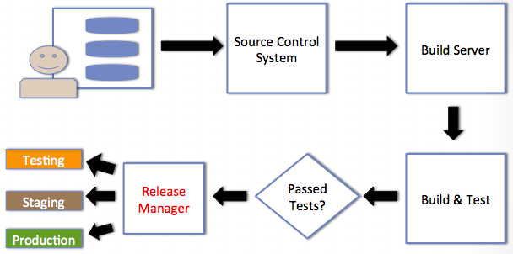
Security
Locking Down Environments Enforces Consistency
Notes:
If all permissions (except for db_datareader & maybe db_datawriter) are removed from all environments except for Development, then all changes are forced into the continuous delivery route. The only way to get a change into production is through the continuous delivery process.
If the Production DBA needs to make an emergency change, they should be diligent for getting that change back into source control or work the process.

Slide 20

Standardization & Consistency
Standards Are Critical for Any Development Shop
Not just for developers
Standards Should Be:
Easy to Follow
Not Overly Complicated
Continuous Delivery = Repeatable = Consistency
Notes:
Development standards
Testing standards
Use the continuous delivery process to enforce the standards.
Continuous delivery allows the process to be repeatable which in turn is consistent.

Slide 21
Standardization & Consistency
Source Control System
Build Server
Testing
Passed Tests?
Build & Test
Release Manager
Staging
Production
Notes:
If we look at the path of continuous delivery from a standards view point, all development changes should be forced through the continuous delivery process. With security locked down, there isn’t any good way to get changes into production.

Slide 22
Standardization & Consistency
Source Control System
Build Server
Testing
Passed Tests?
Build & Test
Release Manager
Staging
Production
Notes:
If we look at the path of continuous delivery from a standards view point, all development changes should be forced through the continuous delivery process. With security locked down, there isn’t any good way to get changes into production.

Slide 23
Standardization & Consistency
Source Control System
Build Server
Testing
Passed Tests?
Build & Test
Release Manager
Staging
Production
Notes:
If we look at the path of continuous delivery from a standards view point, all development changes should be forced through the continuous delivery process. With security locked down, there isn’t any good way to get changes into production.

Slide 24
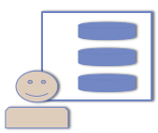
Collaboration
Forces Developers to Talk to Other Developers
Forces Developers to Talk to DBA’s
Forces DBA’s to Talk to Developers
Integration
Notes:
If the environment is in a dedicated model, meaning each developer has a copy of the database, then developers must communicate with each other to avoid conflicts when checking in.
Same is also true for the database developers and/or DBA’s.

Slide 25

Deployments
Using a Release Manager
Probably Not Your Normal Routine
Possible One Click Deployments
Code
Database
Deploy on a Schedule
Set it & Forget it
Notes:
Trusting the tools that you have in place to handle the deployments, such as Octopus Deploy is different than hitting F5.
Deployments become easier to maintain

Slide 26


Slide 27

The Salvation..
Continuous Delivery Will….
Help Reduce Your Security Foot Print
Enforce Consistent Methods
Enforce Consistent Testing
Speed up Delivery to All Environments
Faster Feedback to Develop Teams
Reduce the DBA Bottleneck
All of the Above Will…..

Slide 28
The Salvation..
Continuous Delivery Will….
Help Reduce Your Security Foot Print
Enforce Consistent Methods
Enforce Consistent Testing
Speed up Delivery to All Environments
Faster Feedback to Develop Teams
Reduce the DBA Bottleneck
All of the Above Will…..
SET YOU FREE!!

Slide 29
Resources
Octopus Deploy - https://octopusdeploy.com/
Team City - https://www.jetbrains.com/teamcity/
Jenkins - https://jenkins-ci.org/
SQL Enlight - http://www.ubitsoft.com/products/sqlenlight/
TsqlT - http://tsqlt.org/
SQL Test - http://www.red-gate.com/products/sql-development/sql-test/
Redgate DLM - http://www.red-gate.com/solutions/database-devops/
Redgate DLM Dashboard -http://www.red-gate.com/products/dlm/dlm-dashboard/
Redgate State of DevOps - https://www.red-gate.com/solutions/database-devops/report
eBook - https://leanpub.com/database-lifecycle-management/
eBook Contributions - https://www.simple-talk.com/collections/database-lifecycle-management-patterns-practices-library/

Slide 30
THANK YOU!!!!
john@dcac.co
http://linkedin.com/in/sqlrus
@SqlRUs
http://www.sqlrus.com

